Slide 1

Restaurant Revenue Prediction using Machine Learning Algorithms
Introduction to Data Science DS 501
Professor Nathaniel D. Bastian
Presented By Team 5-
Muhammad Ehtisham Abid
Rushabh Lodha
Sneha Shete

Slide 2
1. Problem Statement
Large investments of time and capital are required to run a restaurant business. If the business fails, the investing party incurs heavy loss.
Our project considers and examines various parameters from the given data sets. The outcome of the analysis will display improved investments on the restaurant business.
The objective is to assist people wanting to make investments in the restaurant business.

Slide 3
2. Literature Review
Referred to reliable discussion forums and TFI reports that best described the problem at hand in more details.
Found excellent approaches that could be used to solve the identified problem, best predictive models that could be potentially used to provide closest of predictions.
Data Processing was very crucial to us, as we gleaned disparities between features for the data sets.

Slide 4
3. Assumption
Referring to the articles that we discussed in the literature review. We can conclude that Random Forest provides us the best prediction for the revenue of the restaurants.
The models that we are about to discuss in this presentation are comparing its result with the predictive revenue that we obtained using the Random Forest on the test set.

Slide 5
4. Data Set
The Dataset consists of following fields:
ID: Restaurant ID
Open Date: Date that the restaurant opened in the format M/D/Y
City: The city name that the restaurant resides in
City Group: The type of city can be either big cities or other
Type: The type of the restaurant where FC - Food Court, IL - Inline, DT - Drive through and MB – Mobile
P-Variables (P1, P2, ......, P37): These are the P-variables and are a measure of the following data -
Demographic Data: Population, age, gender distribution and development scale.
Real Estate Data: M2 of the location, front façade, car parking etc.
Commercial Data: Schools, banks, etc.
Revenue: The Revenue Column indicates annual (transformed) revenue and is the primary target of predictive analysis.

Slide 6
5. Research Questions
How many predictor variables are present in the data set?
What are the data types of predictors in the data set?
How many significant predictors are present in data set?
How to split the open date predictor into days, months, and years?
Are there any additional variables utilized in test data sets that are missing in the training data set?
What does the variable set from P1-P37 signify in test/training data set?

Slide 7
6. Project Objective
Prediction of Revenue for all the restaurants in the training data set using different predictive models

Slide 8
7. Data Preparation
Formatted Open-Date: Conversion of date into its respective days, months and years. New column consisting count of the days & months from the restaurants opening.
Outlier Removal: Dropping data of restaurants having annual revenue more than 16,000,000.
Data Filtration: Conversion of Categorical Data Types into numeric data types to perform predictive analysis.
Type: Conversion of FC, DT, IL, & MB into 1,2,3,4 numeric values respectively
Dropping column named cities as train data set had 38 unique values whereas test data set has 54 unique values for the same column.

Slide 9
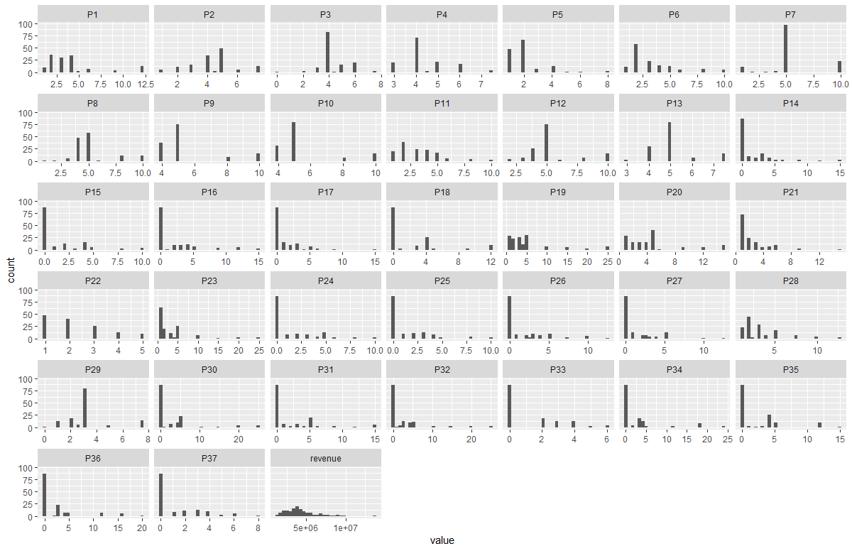
Variation in P-values
P-values comprises of real estate data, commercial data and population related information. Following is the histogram plot of the obfuscated values of P variables:

Slide 10
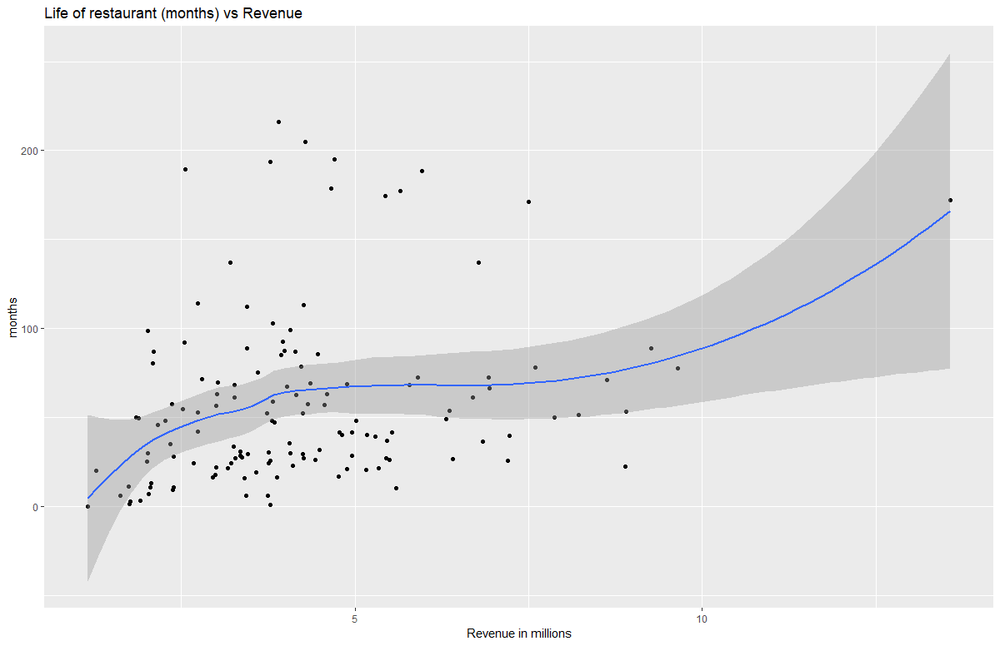
Revenue vs Month Commencement

Slide 11
8. Proposed Methodologies
Prediction of Restaurant Revenue on the test set is obtained by following predictive models:
Random Forest
Logistic Regression
Lasso Regression
Ridge Regression
Principal Component Regression
Partial Least Square
Backward Selection
Stepwise Selection
Linear Regression
Gradient Boosting Machine
Support Vector Machine

Slide 12
Random Forest
Random forest is an ensemble of decision trees created using random variable selection and bootstrap aggregating. At each node of the tree, the split is created according to the random subset of the variables.
Model in R using Random Forest:
fit = randomForest(revenue~., train, ntree = 1000) varImpPlot(fit) predrf = predict(fit, test, type = "response") Predrf

Slide 13
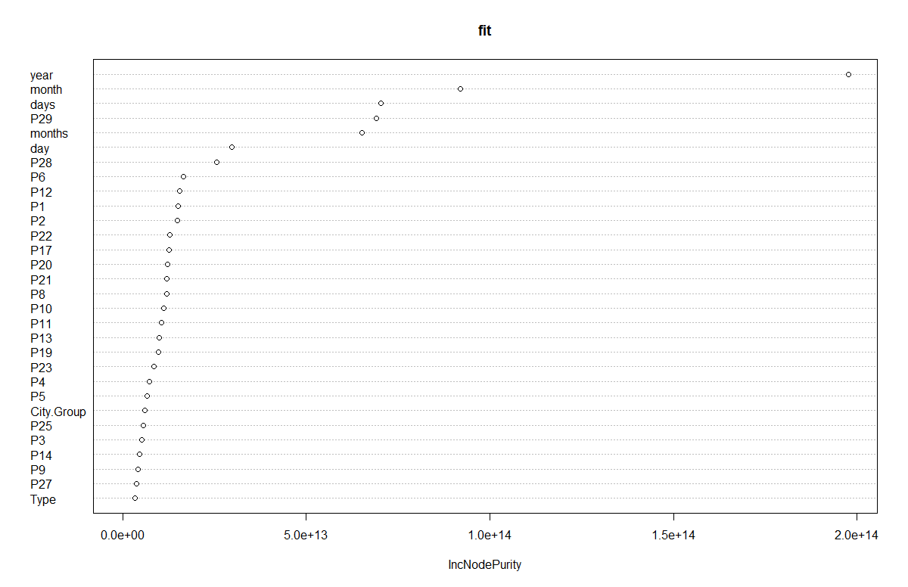
Variable Importance Plot

Slide 14
Gradient Boosting Machine
GBM produces a prediction model in the form of an ensemble of weak prediction models which typically are decision trees. This model is used to handle variety of loss function.
Model in R using Random Forest:
gbmmodel <- gbm(revenue ~ City.Group+Open.Date+Type+P8+P26+P28+Open.Year,data = train ) predgbm <- predict(gbmmodel, n.trees = gbmmodel$n.trees, test) predgbm

Slide 15
Principal Component Regression
This is regression analysis technique based on principal component analysis that considers regressing the outcome on a set of predictors based on its standard linear regression model however uses PCA for estimating unknown regression coefficients.
Model in R using PCR:
pcr <- pcr(revenue ~ City.Group+Open.Date+Type+P8+P26+P28+Open.Year, data = train, scale = TRUE, validation = "CV") validationplot(pcr, val.type = "MSEP") predpcr <- predict(pcr, test, ncomp = 6) predpcr

Slide 16
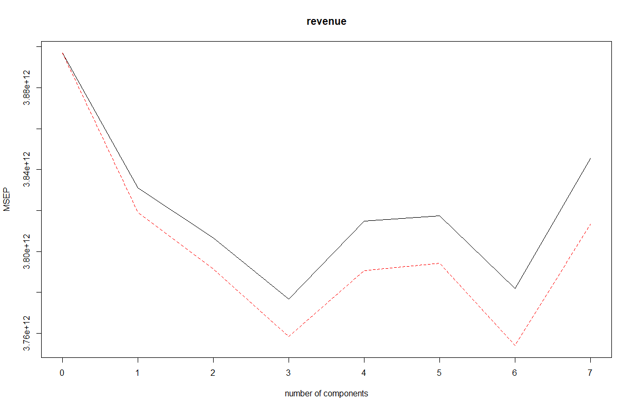
PCR Plot (No. of components vs Mean Squared Error of Prediction)

Slide 17
Lasso Regression
Lasso Regression is an absolute shrinkage and selection method used for analyzing the performance for both variable selection and regularization to enhance the prediction accuracy and interpretability of the statistical model it generates.
Model in R using Lasso Regression Forest:
lasso <- glmnet(trainmatrix, train$revenue) cvlasso <- cv.glmnet(trainmatrix, train$revenue) bestlambdalasso <- cvlasso$lambda.min pred.lasso <- predict(lasso, s = bestlambdalasso, newx = testmatrix) pred.lasso

Slide 18
Ridge Regression
Ridge Regression is a technique for analyzing multiple regression data that suffer from multicollinearity. When it occurs, least squares estimates are unbiased, but their variances are large thus they are far from the true values.
Model in R using Ridge Regression Forest:
ridge <- glmnet(trainmatrix, train$revenue) glmridge <- cv.glmnet(trainmatrix, train$revenue) bestlambda <- glmridge$lambda.min pred.ridge <- predict(ridge, s = bestlambda, newx = testmatrix) pred.ridge

Slide 19
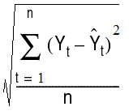
9. Evaluation
We calculated the performance of all the predictive models using the root mean squared error of the test data set revenue.
RMSE =
Where ‘Y_{t}’ is the actual revenue of the i^{th} restaurant and ‘Ŷt’ is the predicted revenue of the i^{th} restaurant.

Slide 20
10.Computation and Results
Logistic Regression: 1131755
Lasso Regression: 1111835
Ridge Regression: 1116012
Principal Component Regression: 1103825
Partial Least Square: 1127979
Backward Selection: 1122023
Stepwise Selection: 1122023
Linear Regression: 1131755
Gradient Boosting Machine: 1103778
Support Vector Machine: 1260842

Slide 21
11.Conclusion
According to the literature review, Random Forest algorithm works best for prediction of revenue. So, we add this prediction as a revenue column in our test set and compare it with the predictions obtained from other predictive models. Other best results are obtained from Gradient Boosting Machine method and Principal Component Regression.
Top 5 predictive models for this data set are:
Random Forest
Gradient Boosting Machine
Principal Component Regression
Lasso Regression
Ridge Regression

Slide 22
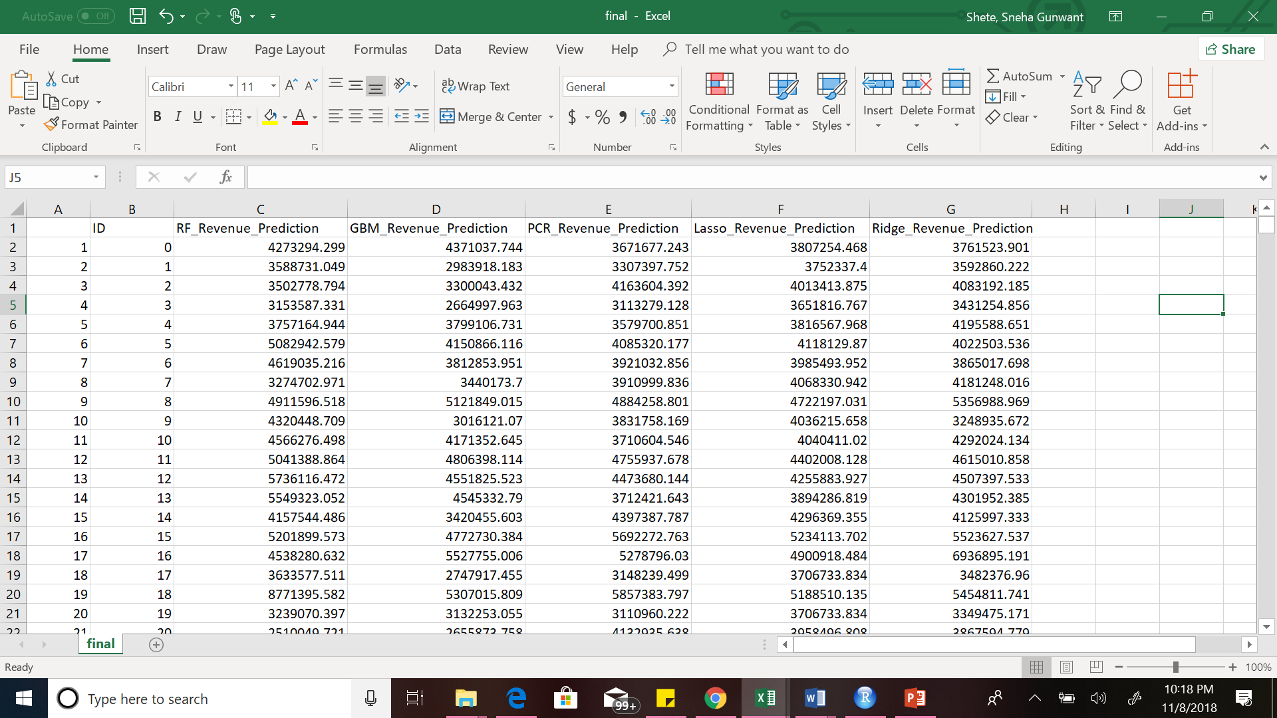
We have created a csv file named final that comprises of the revenue prediction obtained from the above top 5 models.

Slide 23
12. Recommendations & Future Work
We realize the importance of data processing in comparison to the implementation of the machine learning algorithms. Using R package implementations, computing RMSE was easier.
To lower the RMSE, data processing is must. We realized the significance of performance of our model could use the K-Means clustering and k- Nearest Neighbors to deal with the unaccounted problem.
In this project, data processing and visualization was problematic due to many obscured P-variables.
The RMSE is not the only consideration while creating a model, interpretation and pace also matters.

Slide 24
13. References
Restaurant Revenue Prediction | Kaggle. (2018). Retrieved from https://www.kaggle.com/c/restaurant-revenue-prediction
Predictive modeling and machine learning in R with the caret package. (2018). Retrieved from http://zevross.com/blog/2017/09/19/predictive-modeling-and-machine-learning-in-r-with-the-caret-package/
Shirley Mills. (2018). Predicting Kaggle Restaurant Annual Revenue with Support Vector Machine and Random Forest. Ottawa. Retrieved from http://kpei.me/blog/wp-content/uploads/2015/05/TFIKaggleReport.pdf
Etrue Howard, E. (2018). TFI Restaurant Revenue Classification and Prediction. Retrieved from https://www.researchgate.net/publication/301620224_A_REPORT_ON_TFI_Reataurant_Revenue_Classification_and_Prediction

Slide 25
Thank You!!!!
Q&A

